Slide 1

Database System
Lecture 1
Engr. Dr SAIMA WASEEM
School of Systems and Technology (SST)
Artificial Intelligence Faculty

Slide 2
About Instructor
Education
        Ph.D. (Electrical Engineering specialized in Computer Engineering)
        Universiti Teknologi Malaysia (UTM), Johor, Malaysia.
        M.Sc. (Computer Engineering)
        National University of Science and Technology (NUST), Rawalpindi, Pakistan.
        B.S. (Computer Engineering)
        Balochistan University of Information Technology Engineering & Management Sciences (BUITEMS), Quetta, Pakistan.
Professional Experience
    Assistant Professor, Sept 2024 to Date
      Artificial Intelligence Faculty (UMT, Lahore, Pakistan)
    Junior Visiting Researcher (Faculty of Electrical Engineering, Universiti Teknologi Malaysia (UTM), Johor, Malaysia)
    Lecturer (Department of Computer Sciences, Lahore Leads University (LLU), Lahore Campus, Lahore, Pakistan)
    Lecturer (Department of Computer Sciences, Bahauddin Zakariya University (BZU), Lahore Campus, Pakistan)
CF

Slide 3
About Instructor
Research Interests
        Deep Fake
        Deep Learning
        Machine Learning
        Medical Imagining
Professional Information
    Email: Saima.waseem@umt.edu.pk
    Office: Cohort Building CB 708 (Cabin No: 8)
    Office Hours: Monday and Tuesday (11am-12Pm)
CF

Slide 4
Course Information
This course introduces the principles of database systems with a focus on data modeling, relational databases, SQL, normalization, and database design. It also covers storage mechanisms, query optimization, transaction management, and database security. The course aims to develop foundational skills for designing, implementing, and managing databases using modern DBMS tools.
CF

Slide 5
Course resources
Fundamentals of Database Systems by Elmasri & Navathe
Database System Concepts by Silberschatz, Korth, & Sudarshan
Database Management Systems by Raghu Ramakrishnan
Online resources: DBMS slides from db-book.com, W3Schools SQL tutorials, etc.
CF

Slide 6
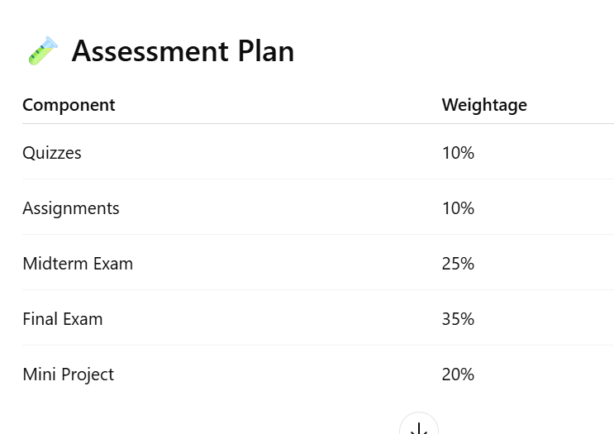
CF

Slide 7
Outline
History of Database Systems
Database-System Applications
Purpose of Database Systems
View of Data
Database Languages
Database Design
Database Engine
Database Architecture
Database Users and Administrators

Slide 8
Database Systems
DBMS contains information about a particular enterprise
  Collection of interrelated data
  Set of programs to access the data
  An environment that is both convenient and efficient to use
Database systems are used to manage collections of data that are:
  Highly valuable
  Relatively large
  Accessed by multiple users and applications, often at the same time.
A modern database system is a complex software system whose task is to manage a large, complex collection of data.
Databases touch all aspects of our lives

Slide 9
History of Database Systems (Cont.)
1980s:
  Research relational prototypes evolve into commercial systems
    SQL becomes industrial standard
  Parallel and distributed database systems
    Wisconsin, IBM, Teradata
  Object-oriented database systems
1990s:
  Large decision support and data-mining applications
  Large multi-terabyte data warehouses
  Emergence of Web commerce

Slide 10
History of Database Systems (Cont.)
2000s
  Big data storage systems
    Google BigTable, Yahoo PNuts, Amazon,
    “NoSQL” systems.
  Big data analysis: beyond SQL
    Map reduce and friends
2010s
  SQL reloaded
    SQL front end to Map Reduce systems
    Massively parallel database systems
    Multi-core main-memory databases

Slide 11
Database Applications Examples
Enterprise Information
  Sales: customers, products, purchases
  Accounting: payments, receipts, assets
  Human Resources: Information about employees, salaries, payroll taxes.
Manufacturing: management of production, inventory, orders, supply chain.
Banking and finance
  customer information, accounts, loans, and banking transactions.
  Credit card transactions
  Finance: sales and purchases of financial instruments (e.g., stocks and bonds; storing real-time market data
Universities: registration, grades

Slide 12
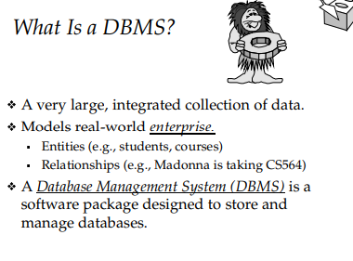
CF

Slide 13
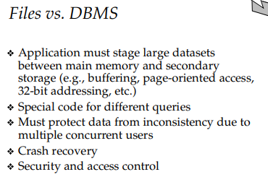
CF

Slide 14
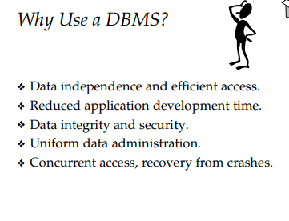
CF

Slide 15
Purpose of Database Systems
In the early days, database applications were built directly on top of file systems, which leads to:
Data redundancy and inconsistency: data is stored in multiple file formats resulting induplication of information in different files
Difficulty in accessing data
  Need to write a new program to carry out each new task
Data isolation
  Multiple files and formats
Integrity problems
  Integrity constraints (e.g., account balance > 0) become “buried” in program code rather than being stated explicitly
  Hard to add new constraints or change existing ones

Slide 16
Purpose of Database Systems (Cont.)
Atomicity of updates
  Failures may leave database in an inconsistent state with partial updates carried out
  Example: Transfer of funds from one account to another should either complete or not happen at all
Concurrent access by multiple users
  Concurrent access needed for performance
  Uncontrolled concurrent accesses can lead to inconsistencies
    Ex: Two people reading a balance (say 100) and updating it by withdrawing money (say 50 each) at the same time
Security problems
  Hard to provide user access to some, but not all, data
Database systems offer solutions to all the above problems

Slide 17
University Database Example
In this text we will be using a university database to illustrate all the concepts
Data consists of information about:
  Students
  Instructors
  Classes
Application program examples:
  Add new students, instructors, and courses
  Register students for courses, and generate class rosters
  Assign grades to students, compute grade point averages (GPA) and generate transcripts

Slide 18
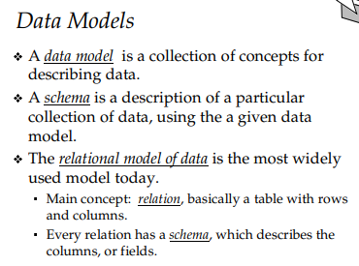
CF

Slide 19
View of Data
A database system is a collection of interrelated data and a set of programs that allow users to access and modify these data.
A major purpose of a database system is to provide users with an abstract view of the data.
  Data models
    A collection of conceptual tools for describing data, data relationships, data semantics, and consistency constraints.
  Data abstraction
    Hide the complexity of data structures to represent data in the database from users through several levels of data abstraction.

Slide 20
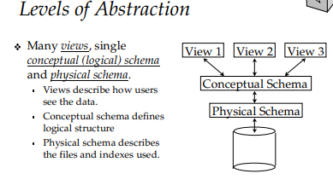
CF

Slide 21
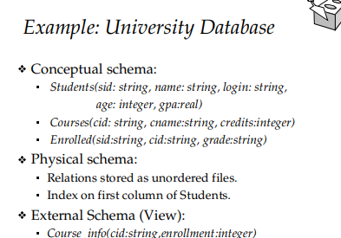
CF

Slide 22
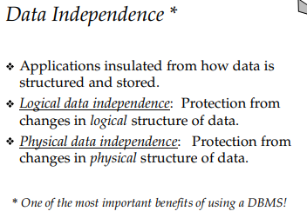
CF

Slide 23
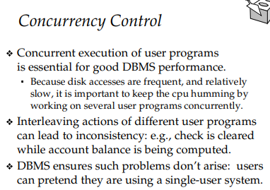
CF

Slide 24
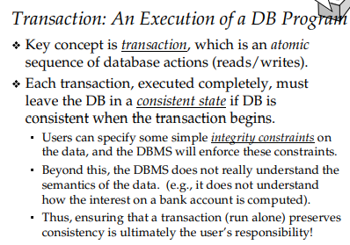
CF

Slide 25
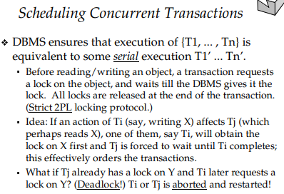
CF

Slide 26
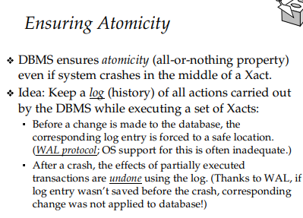
CF

Slide 27
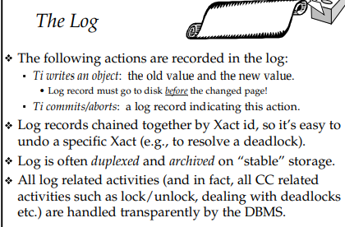
CF

Slide 28
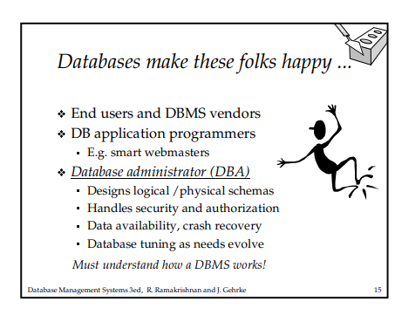
CF

Slide 29
CF

Slide 30
Data Models
A collection of tools for describing
  Data
  Data relationships
  Data semantics
  Data constraints
Relational model
Entity-Relationship data model (mainly for database design)
Object-based data models (Object-oriented and Object-relational)
Semi-structured data model (XML)
Other older models:
  Network model
  Hierarchical model

Slide 31
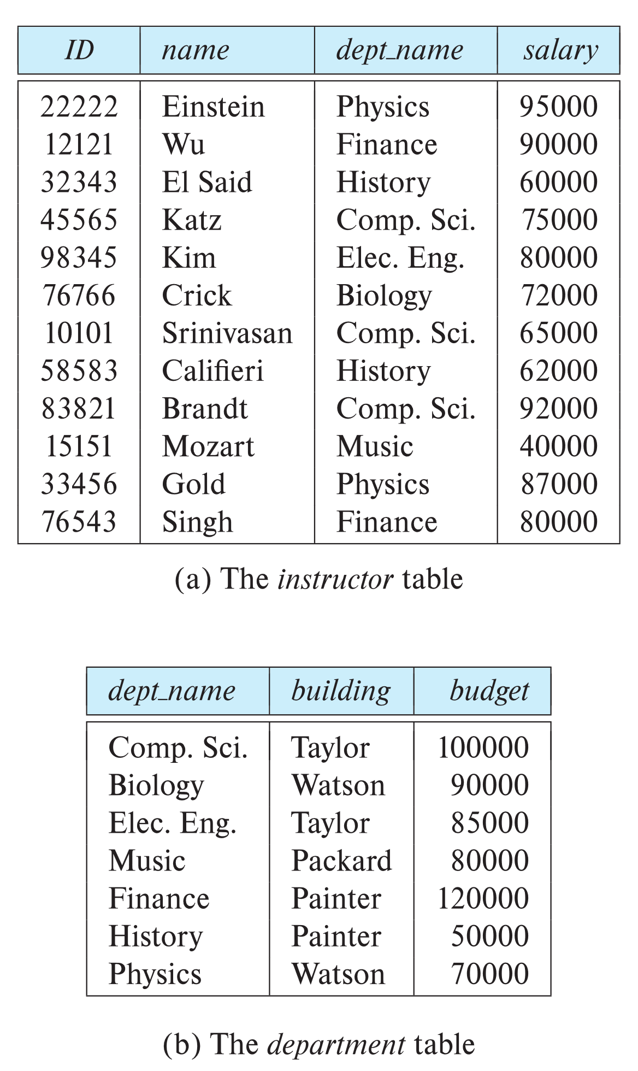

Relational Model
All the data is stored in various tables.
Example of tabular data in the relational model
Columns
Rows
Ted Codd
Turing Award 1981

Slide 32
A Sample Relational Database

Slide 33
Levels of Abstraction
Physical level: describes how a record (e.g., instructor) is stored.
Logical level: describes data stored in database, and the relationships among the data.
  type instructor = record
  ID : string;
  name : string;
  dept_name : string;
  salary : integer;
        end;
View level: application programs hide details of data types. Views can also hide information (such as an employee’s salary) for security purposes.

Slide 34
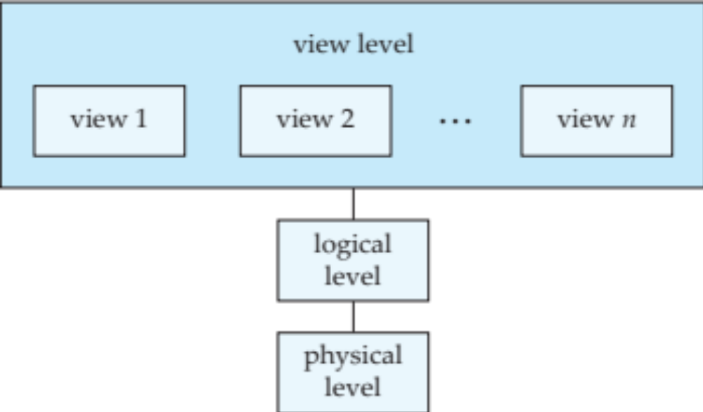
View of Data
An architecture for a database system

Slide 35
Instances and Schemas
Similar to types and variables in programming languages
Logical Schema – the overall logical structure of the database
  Example: The database consists of information about a set of customers and accounts in a bank and the relationship between them
    Analogous to type information of a variable in a program
Physical schema – the overall physical structure of the database
Instance – the actual content of the database at a particular point in time
  Analogous to the value of a variable

Slide 36
Physical Data Independence
Physical Data Independence – the ability to modify the physical schema without changing the logical schema
  Applications depend on the logical schema
  In general, the interfaces between the various levels and components should be well defined so that changes in some parts do not seriously influence others.

Slide 37
Data Definition Language (DDL)
Specification notation for defining the database schema
  Example: create table instructor (
  ID char(5),
  name varchar(20),
  dept_name varchar(20),
  salary numeric(8,2))
DDL compiler generates a set of table templates stored in a data dictionary
Data dictionary contains metadata (i.e., data about data)
  Database schema
  Integrity constraints
    Primary key (ID uniquely identifies instructors)
  Authorization
    Who can access what

Slide 38
Data Manipulation Language (DML)
Language for accessing and updating the data organized by the appropriate data model
  DML also known as query language
There are basically two types of data-manipulation language
  Procedural DML -- require a user to specify what data are needed and how to get those data.
  Declarative DML -- require a user to specify what data are needed without specifying how to get those data.
Declarative DMLs are usually easier to learn and use than are procedural DMLs.
Declarative DMLs are also referred to as non-procedural DMLs
The portion of a DML that involves information retrieval is called a query language.

Slide 39
SQL Query Language
SQL query language is nonprocedural. A query takes as input several tables (possibly only one) and always returns a single table.
Example to find all instructors in Comp. Sci. dept
select name
from instructor
where dept_name = 'Comp. Sci.'
SQL is NOT a Turing machine equivalent language
To be able to compute complex functions SQL is usually embedded in some higher-level language
Application programs generally access databases through one of
  Language extensions to allow embedded SQL
  Application program interface (e.g., ODBC/JDBC) which allow SQL queries to be sent to a database

Slide 40
Database Access from Application Program
Non-procedural query languages such as SQL are not as powerful as a universal Turing machine.
SQL does not support actions such as input from users, output to displays, or communication over the network.
Such computations and actions must be written in a host language, such as C/C++, Java or Python, with embedded SQL queries that access the data in the database.
Application programs -- are programs that are used to interact with the database in this fashion.

Slide 41
Database Design
The process of designing the general structure of the database:
Logical Design – Deciding on the database schema. Database design requires that we find a “good” collection of relation schemas.
  Business decision – What attributes should we record in the database?
  Computer Science decision – What relation schemas should we have and how should the attributes be distributed among the various relation schemas?
Physical Design – Deciding on the physical layout of the database

Slide 42
Database Engine
A database system is partitioned into modules that deal with each of the responsibilities of the overall system.
The functional components of a database system can be divided into
  The storage manager,
  The query processor component,
  The transaction management component.

Slide 43
Storage Manager
A program module that provides the interface between the low-level data stored in the database and the application programs and queries submitted to the system.
The storage manager is responsible to the following tasks:
  Interaction with the OS file manager
  Efficient storing, retrieving and updating of data
The storage manager components include:
  Authorization and integrity manager
  Transaction manager
  File manager
  Buffer manager

Slide 44
Storage Manager (Cont.)
The storage manager implements several data structures as part of the physical system implementation:
  Data files -- store the database itself
  Data dictionary -- stores metadata about the structure of the database, in particular the schema of the database.
  Indices -- can provide fast access to data items. A database index provides pointers to those data items that hold a particular value.

Slide 45
Query Processor
The query processor components include:
  DDL interpreter -- interprets DDL statements and records the definitions in the data dictionary.
  DML compiler -- translates DML statements in a query language into an evaluation plan consisting of low-level instructions that the query evaluation engine understands.
    The DML compiler performs query optimization; that is, it picks the lowest cost evaluation plan from among the various alternatives.
  Query evaluation engine -- executes low-level instructions generated by the DML compiler.

Slide 46

Query Processing
1. Parsing and translation
2. Optimization
3. Evaluation

Slide 47
Transaction Management
A transaction is a collection of operations that performs a single logical function in a database application
Transaction-management component ensures that the database remains in a consistent (correct) state despite system failures (e.g., power failures and operating system crashes) and transaction failures.
Concurrency-control manager controls the interaction among the concurrent transactions, to ensure the consistency of the database.

Slide 48
Database Architecture
Centralized databases
  One to a few cores, shared memory
Client-server,
  One server machine executes work on behalf of multiple client machines.
Parallel databases
  Many core shared memory
  Shared disk
  Shared nothing
Distributed databases
  Geographical distribution
  Schema/data heterogeneity

Slide 49

Database Architecture
(Centralized/Shared-Memory)

Slide 50
Database Applications
Database applications are usually partitioned into two or three parts
Two-tier architecture -- the application resides at the client machine, where it invokes database system functionality at the server machine
Three-tier architecture -- the client machine acts as a front end and does not contain any direct database calls.
  The client end communicates with an application server, usually through a forms interface.
  The application server in turn communicates with a database system to access data.

Slide 51
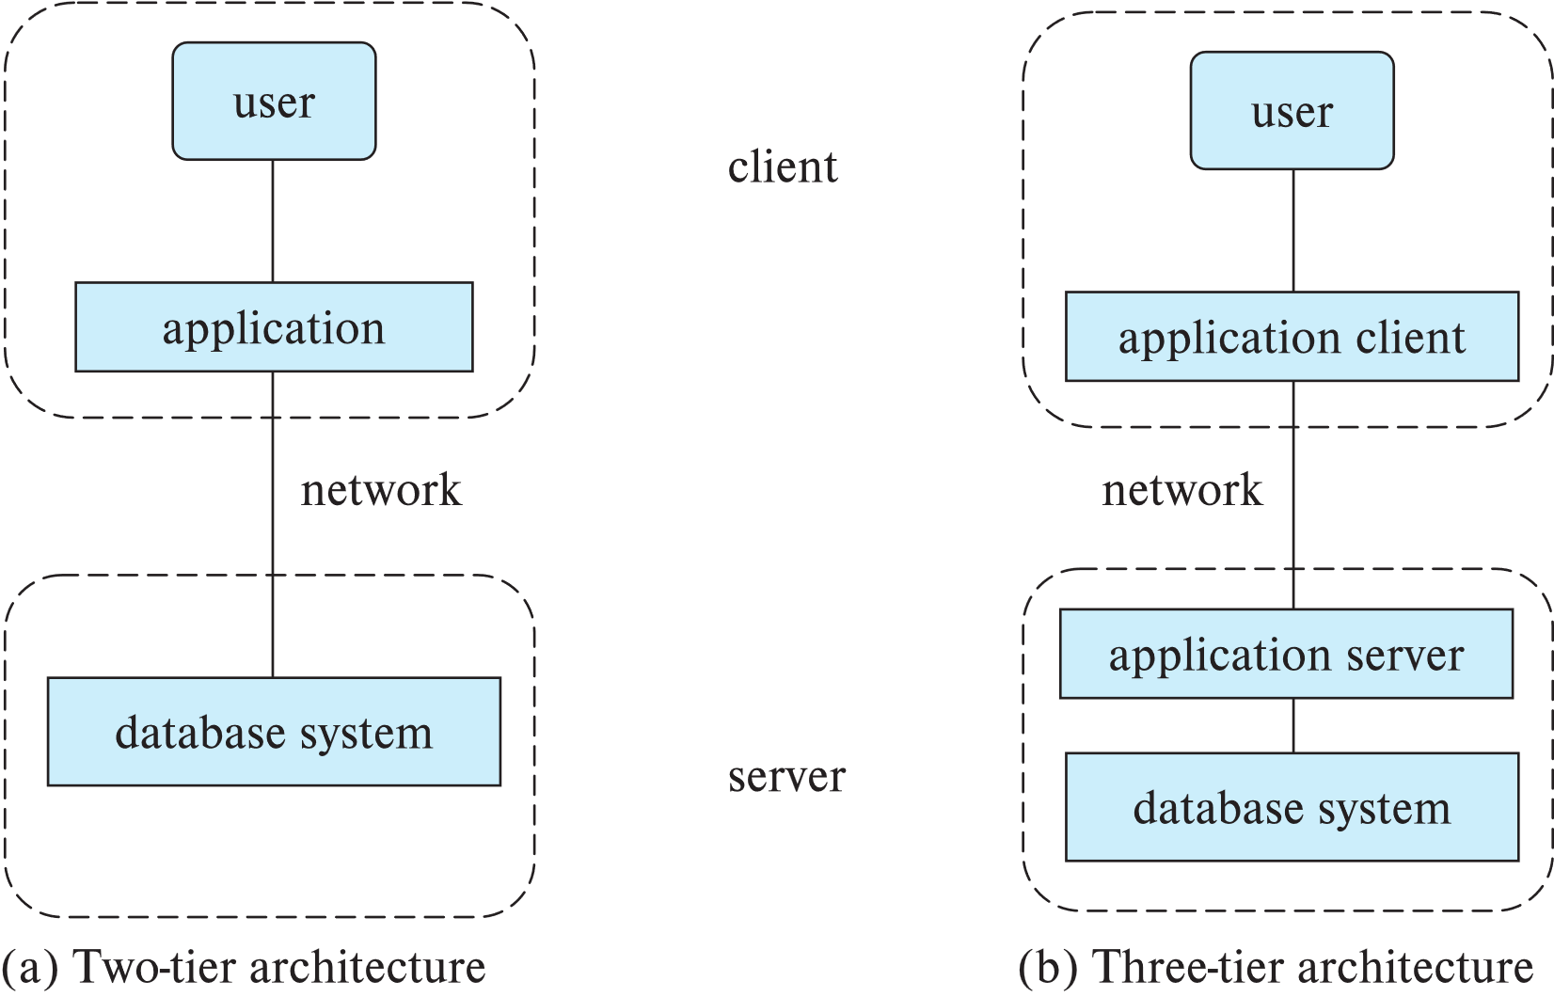
Two-tier and three-tier architectures

Slide 52
Database Users

Slide 53
Database Administrator
A person who has central control over the system is called a database administrator (DBA). Functions of a DBA include:
Schema definition
Storage structure and access-method definition
Schema and physical-organization modification
Granting of authorization for data access
Routine maintenance
Periodically backing up the database
Ensuring that enough free disk space is available for normal operations, and upgrading disk space as required
Monitoring jobs running on the database

